Slide 1
Secure data hiding in images using steganography
Presented By
Student Name : ADHITH AJAY
College Name & Department : SRM IST RAMAPURAM - MCA

Slide 2
OUTLINE
Problem Statement
Technology used
Wow factor
End users
Result
Conclusion
Git-hub Link
Future scope

Slide 3
Problem Statement
Encrypting and sending data through images is a very efficient way for secure communincation]
Using steganography method we can achieve this
We use a least bit insertion method for this purpose
If the original pixel value is 10101100, the LSB method might change it to 10101101 to encode a bit of the message

Slide 4
Technology used
Python
Open CV
OS module
LSB insertion

Slide 5
Wow factors
Highly secure way for data transfer
Difficult to decipher for a normal person
Without password it is even more difficult
Does not consume a lot of size
Very compact to store and handle

Slide 6
End users
Spy groups
Military comms
MNC companies
Police and law enforcement agencies

Slide 7
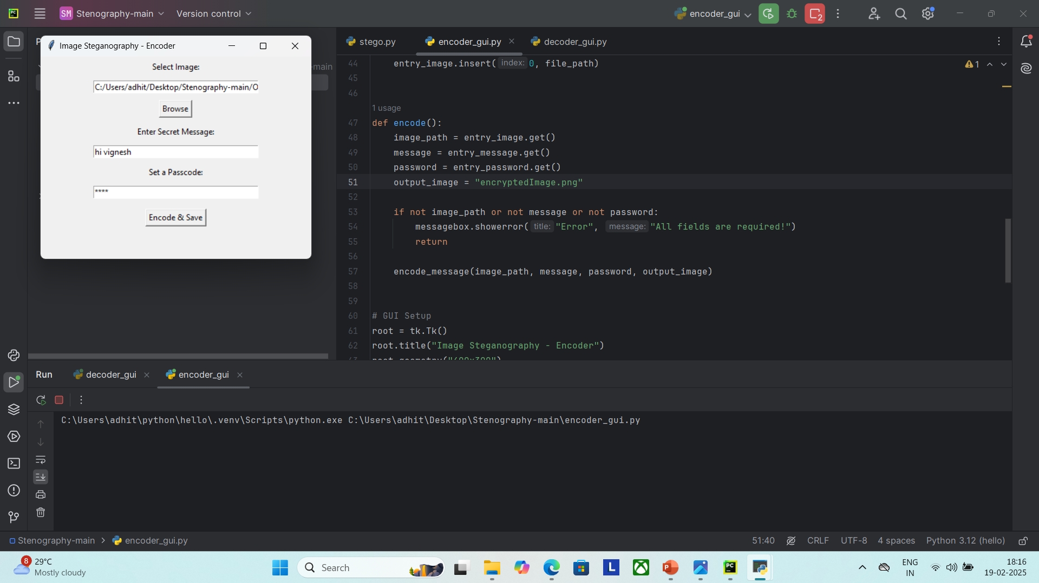
Results
1) The encoding script will enable us to select the image,set message and password

Slide 8
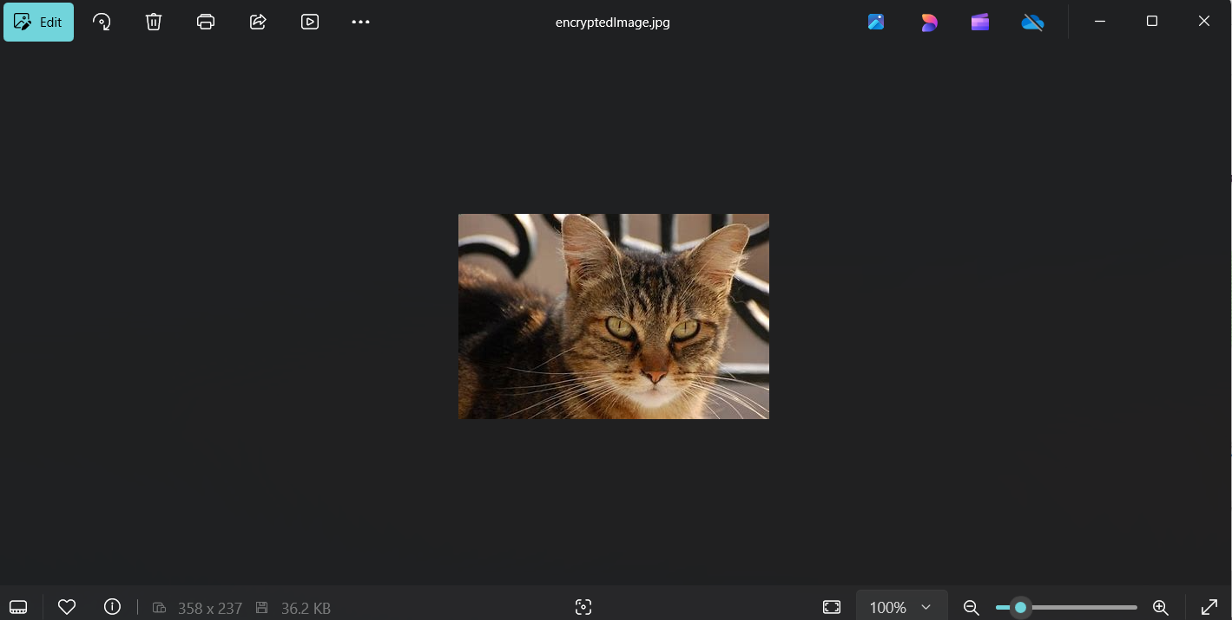
Results

Slide 9
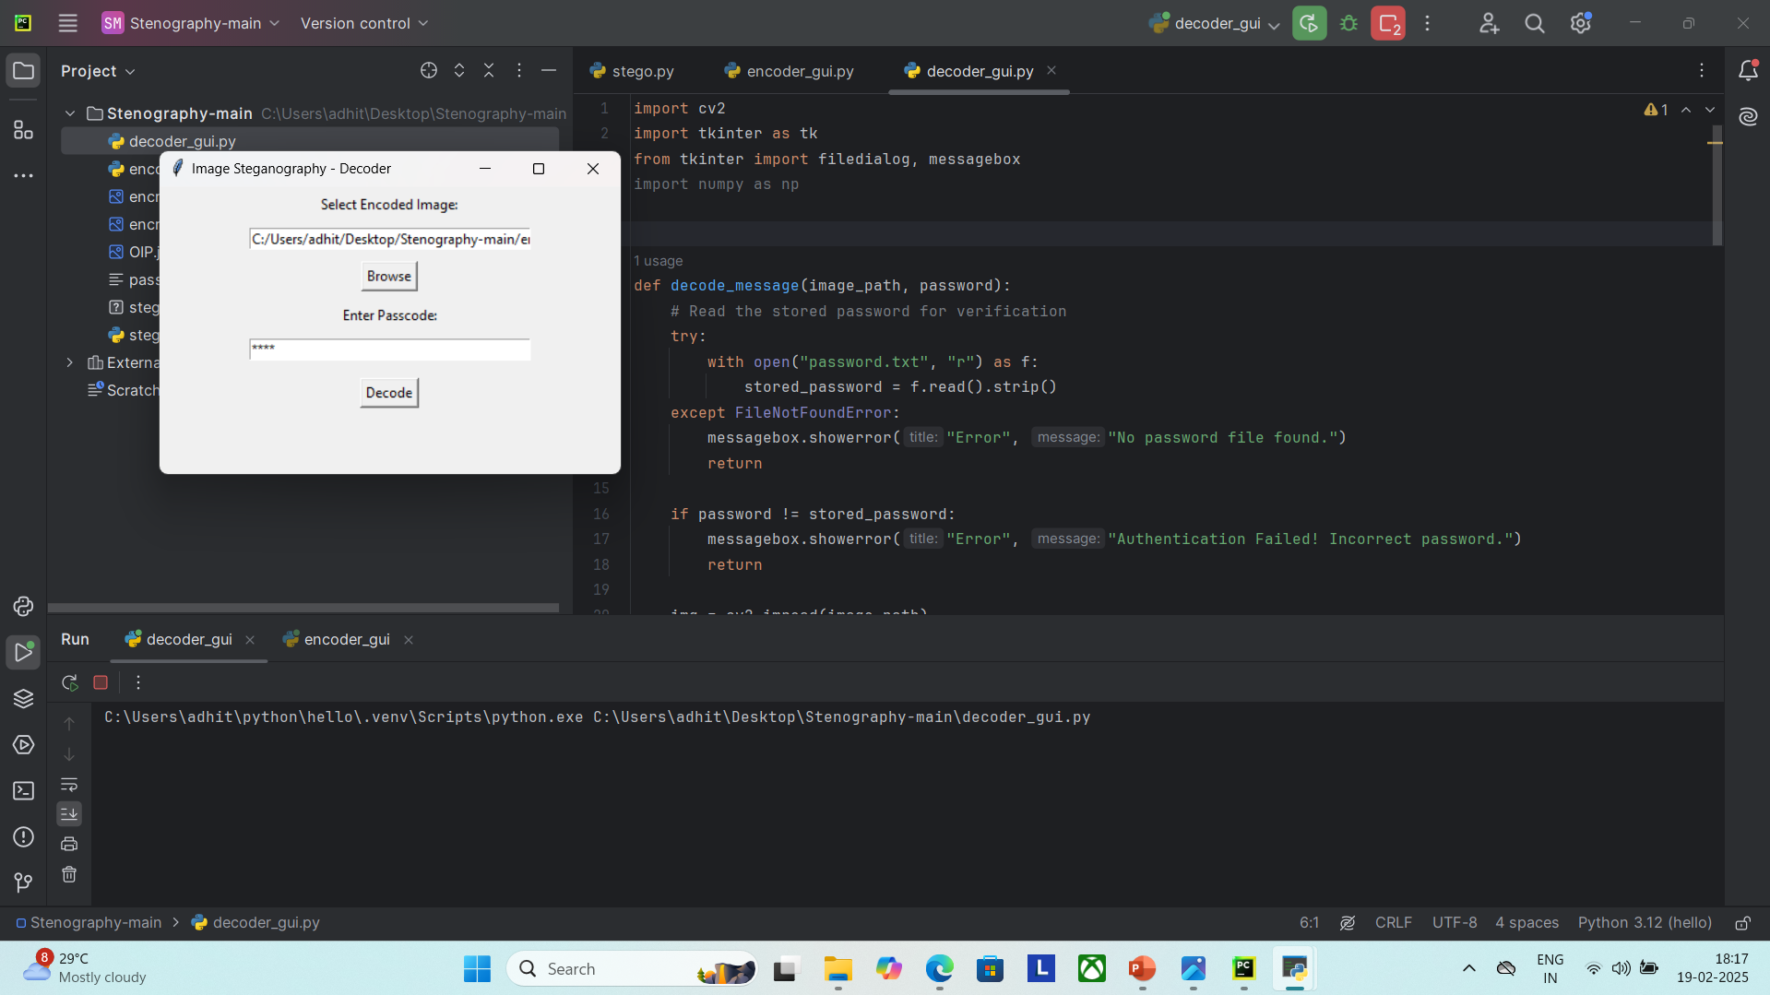
Results
1) The decoding script will enable us to select the image and password

Slide 10
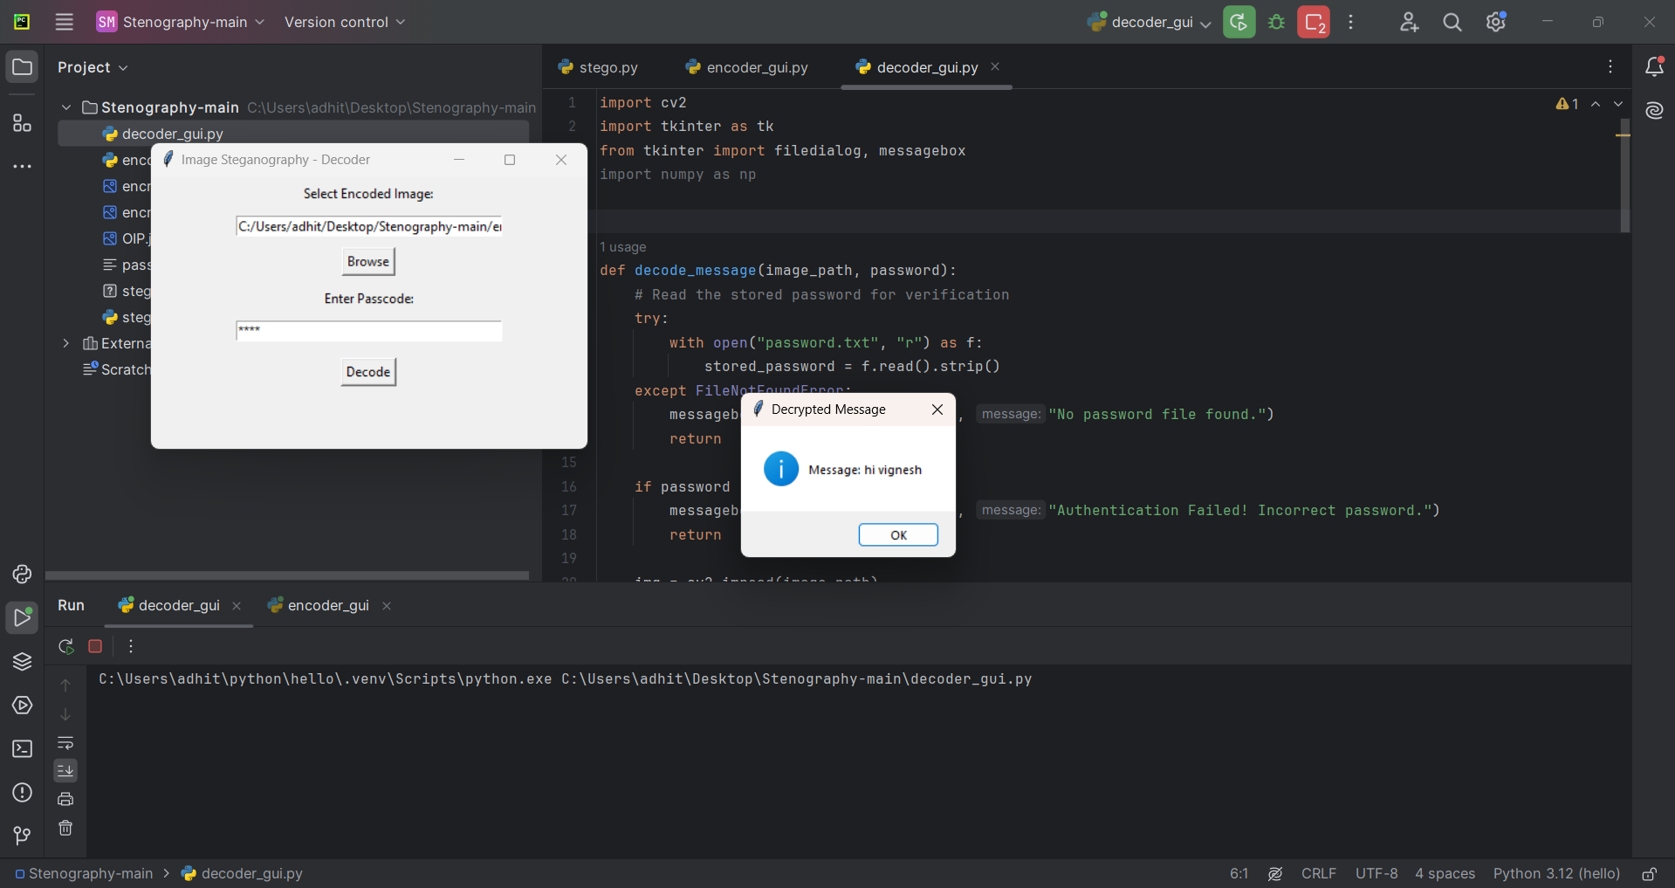
Results
1)After running it we will get the encrypted message

Slide 11
Conclusion
Sucsesfully implemented steganography based data encryption

Slide 12
GitHub Link
https://github.com/quantumboss510/Steganography.git

Slide 13
THANK YOU

